Slide 1

Now Presenting:
Bechdel
The
Test
------------------------------------~A group light purple production~------------------------------

Slide 2
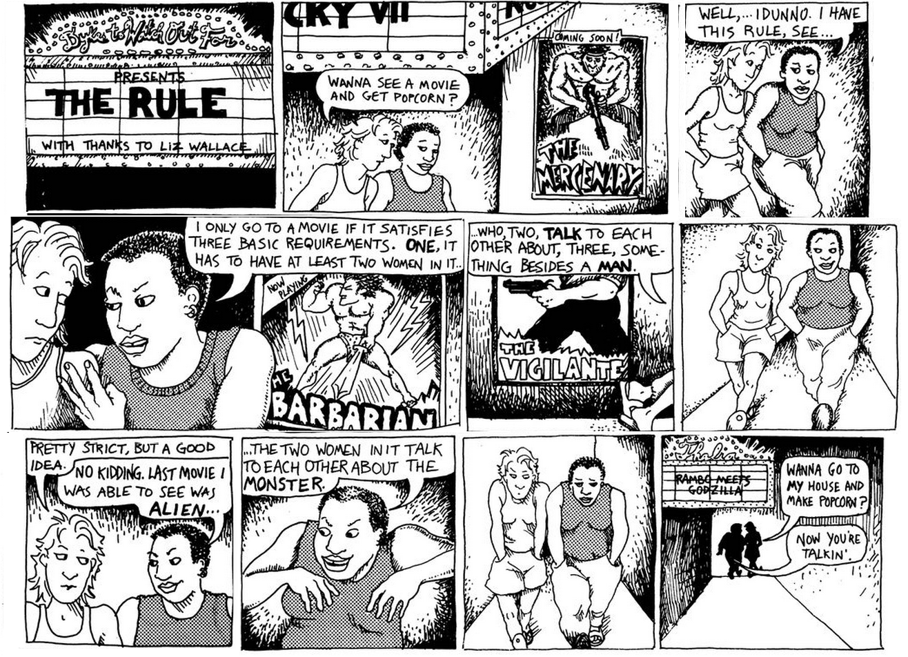
What is the Bechdel Test?
It’s a measure of the representation of women in fiction named for Alison Bechdel the cartoonist whose comic strip Dykes to Watch Out For introduced the test in 1985. It asks:
Are there at least two female characters with names?
Do they talk to each other?
Do they talk to each other about something other than a man?
Movies can score 0 to 3 based on the answers to these questions

Slide 3

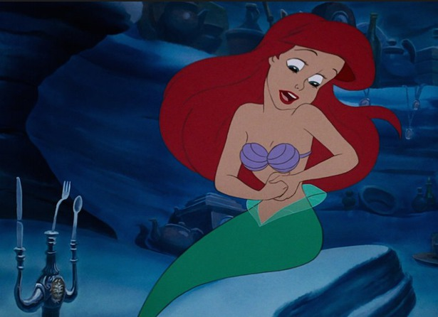
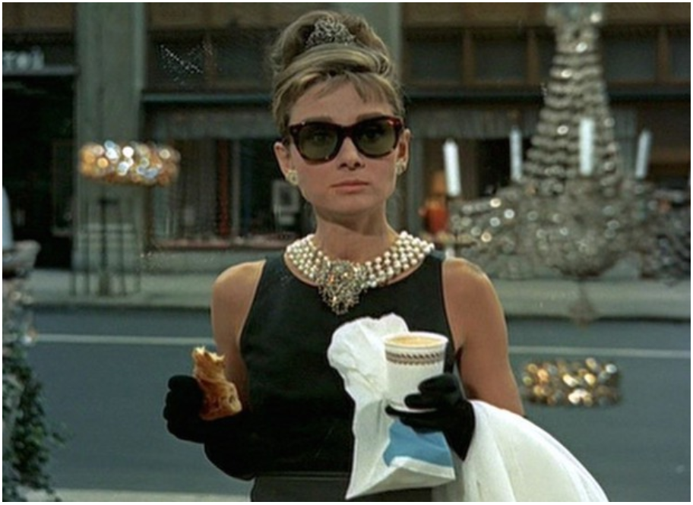


Sounds easy enough, right?
You might be surprised……
Sorry, Scarlett. Still a big……
The Little Mermaid?
The Blind Side?!
Breakfast at Tiffany’s?
Come on, The Avengers Passes, right?

Slide 4






Suddenly, we had a lot of questions…
What’s the breakdown by genre?
Do certain actresses appear in movies that pass?
Do results vary by country?
Do people like movies better if they pass?
Have average Bechdel scores changed over time?
What are movies about that get 0, 1, 2, or 3 ratings?

Slide 5
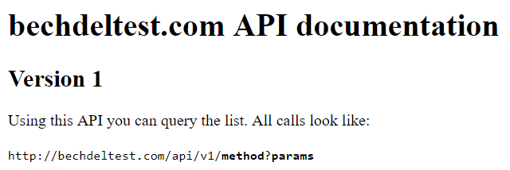

So we went looking for data…
Bechdel API: Users provide information about how many of the 3 tests a movie passes and give the movie a rating of 0 to 3 based on their assessment.
We found 2 APIs
OMDb API: Provides a variety of information about movies. For example: popularity rating, actresses and actors, genre, director, language, plot description, etc.

Slide 6
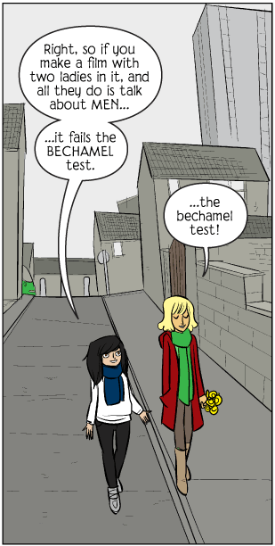

We cleaned our data…
We merged that data from OMDb and Bechdel based on IMDb ID
We reviewed the data to identify errors, inconsistencies, or other issues
We removed data that was not related to movies
We removed rows and columns with significantly incomplete data
We converted html symbols to UTF-8 text

Slide 7






And fueled up for some quality coding!
BY DEVIN

Slide 8
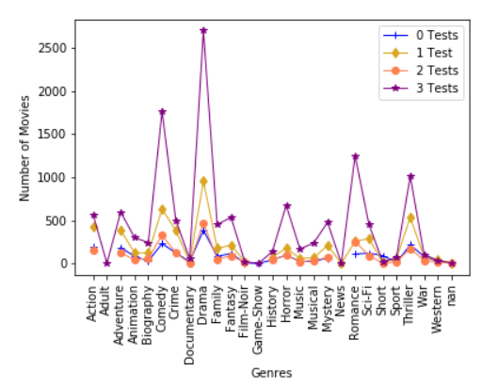
What’s the breakdown by genre?
Comedy, Drama, Romance, and Thriller have the most 3-rated movies.
These genres also have the most 2-rated movies

Slide 9
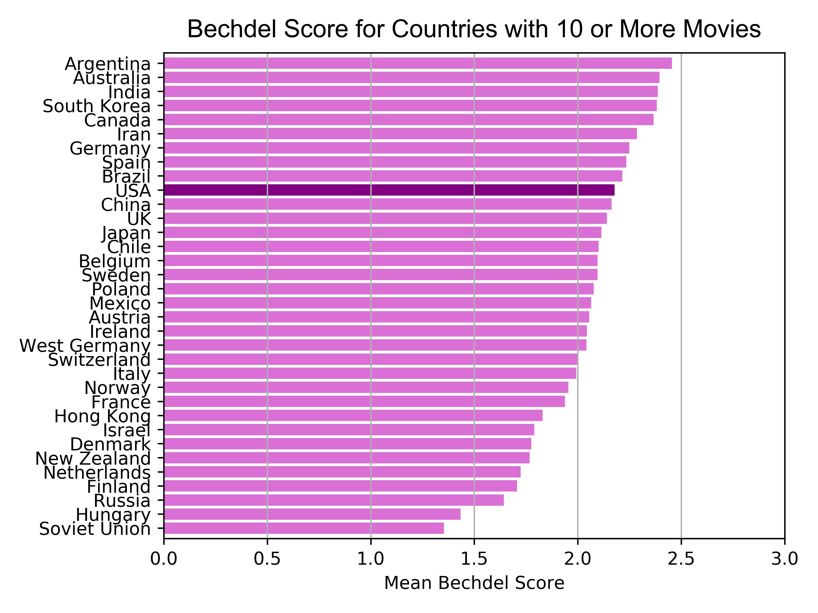
Do average Bechdel scores vary by country?
Given the reputation that big budget Hollywood movies sometimes carry, we were curious to know if US produced movies would fare better or worse on the Bechdel Test…
US ranked 10th in a group of 34 countries that had 10 or more movies in the IMDB/OMDB database in respect to mean Bechdel Score.
US movie mean = 2.18 compared to the international average of 2.03..

Slide 10
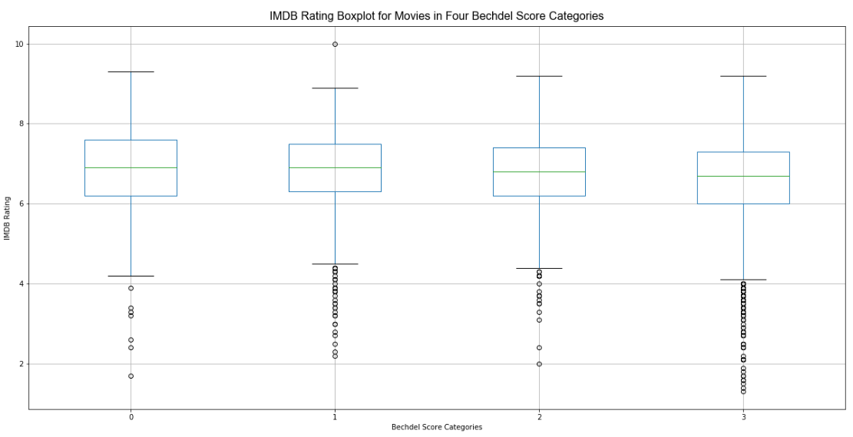
How do high Bechdel-scored movies do in terms of audience popularity?
Our Hypothesis: Movies that score high on the Bechdel Test will be more popular with audiences because of better character development.
Null Hypothesis: No difference between mean IMDB Rating across Bechdel groups.
We performed ANOVA F-test and t-test (on Bechdel 0 and 3 movies)
p-values for both tests < .001, statistically significant differences in means.
We rejected the null hypothesis and conclude that Bechdel 0 movies (m=6.83) have a higher mean audience rating (more popular) than Bechdel 3 movies (m = 6.56).

Slide 11
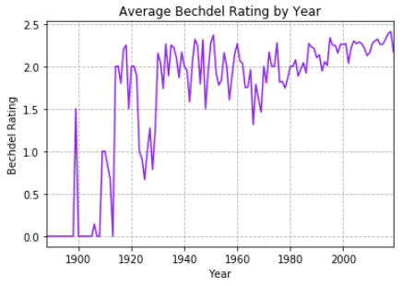
How have Bechdel ratings changed over time?
It appears that the average Bechdel score for movies is increasing over time.
The extreme fluctuations in the early years can partially be attributed to the fact that there are fewer observations.
Our research indicates that women may have played a more significant role in the film industry during the silent movie era (i.e., pre-1927) than they do even today. For example, a woman named Mary Pickford 1916 and was instrumental in founding United Artists Studios 1919. This changed as the film industry became structured around the studio system.
“By the coming of sound in 1927, Lois Weber’s advice to young women considering a career as a director was starkly prescient. “Don’t try it,” she said. “You’ll never get away with it.” From that point on, the studio she worked for, Universal, which had hired so many women in the teens, would not credit a single female director until 1982, when Amy Heckerling made Fast Times at Ridgemont High. “

Slide 12
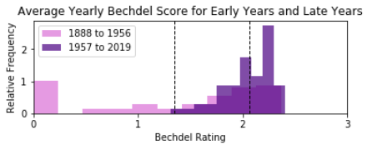
How have Bechdel ratings changed over time?
We performed a t-test to test our Null Hypothesis.
The resulting p-value was: 0.00000002478 which is statistically significant.
We rejected the Null Hypothesis and we can conclude movies in more recent years have a higher Bechdel score on average.
Null Hypothesis: There is no difference between the mean of the Bechdel Scores from 1888 to 1956 and the mean of the Bechdel Scores from 1957 to 2019
Early Years mean: 1.35
Late Years mean: 2.07

Slide 13
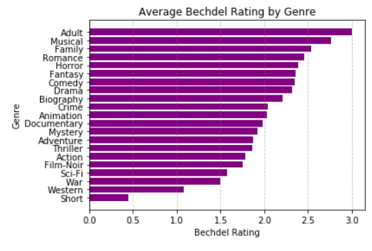
How have Bechdel ratings changed over time by Genre?
Based on our analysis, certain genres have many more observations and therefore more reliable data than others.
We chose a genre from the upper half (Comedy) and a genre from the lower half (Action) with substantial observations for further analysis.

Slide 14
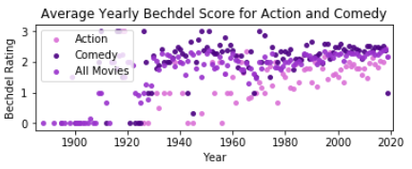
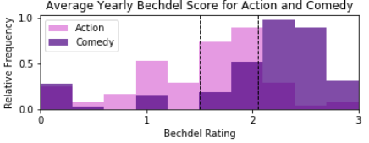
How have Bechdel ratings changed over time by Genre?
Null Hypothesis: There is no difference between the mean of the Bechdel Scores for Comedy and Action
Action Mean: 1.50
Comedy Mean: 2.05
We performed a t-test to test our Null Hypothesis.
The resulting p-value was: 0.0000003693 which is statistically significant.
We rejected the Null Hypothesis and we can conclude that Comedies have a higher Bechdel than Action on average.

Slide 15
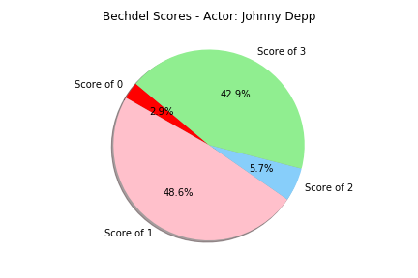
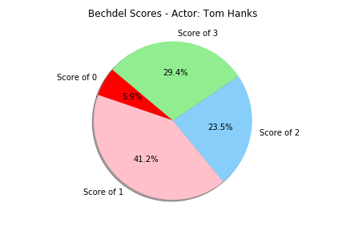
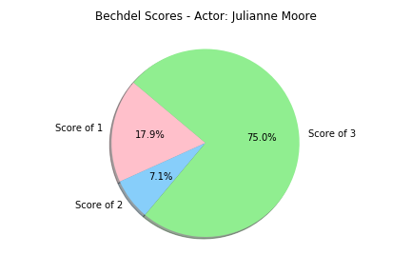
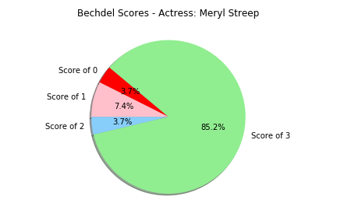
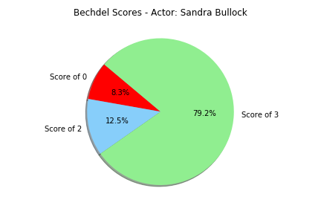
How does the body of work break down?
Actors and Actresses have different levels of commitment to appearing in movies that feature women…..

Slide 16
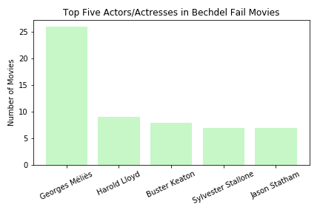
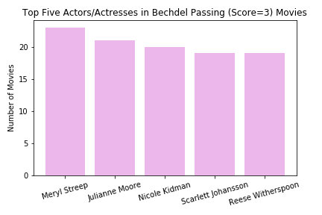
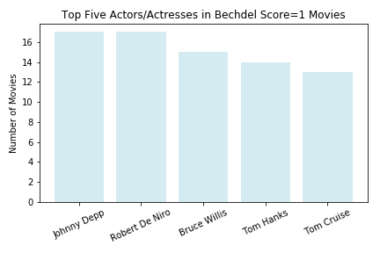
How does the body of work break down?

Slide 17




What key words show up in the plot?
Observe what happens to the words “man” and “woman” as we move from 0 to 3-rated movies

Slide 18
Cast
Git Master
Merge Master
Cow Joke Master
International Director
Art Director
Chris
Emily
Marie
James
Steph

